Slide 1

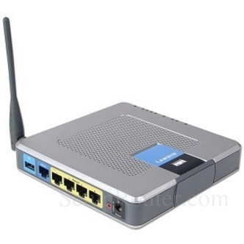
802.1x Network Access
Radius Server

Slide 2

802.1x Network Access
Radius Server
Intel® AMT
MeshCentral

Slide 3

802.1x Network Access
Radius Server
Intel® AMT
Certificate Authority
MeshCentral
Domain Controller

Slide 4
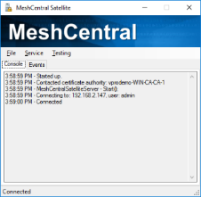
802.1x Network Access
Radius Server
Intel® AMT
Certificate Authority
MeshCentral
Domain Controller
MeshCentral Satellite

Slide 5
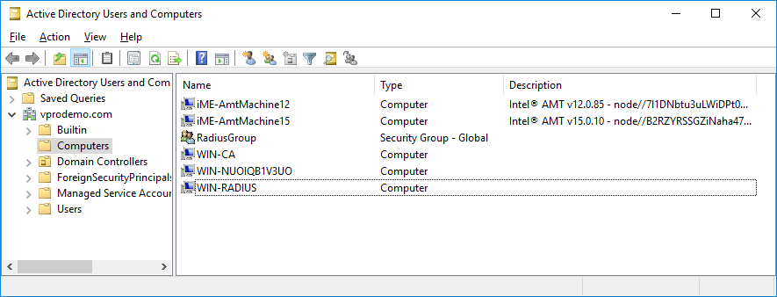
Intel® AMT
Intel® AMT
Radius Server
Intel® AMT

